Slide 1



genome driven signaling heterogeneity in breast cancer: UPDATE
marco tognetti
BodenmillerLab
www.bodenmillerlab.com
imsb.ethz.ch/research/picotti.html
03.09.2018| update

Slide 2
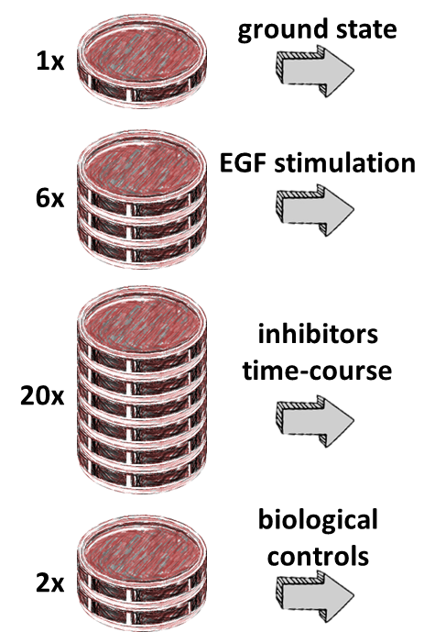
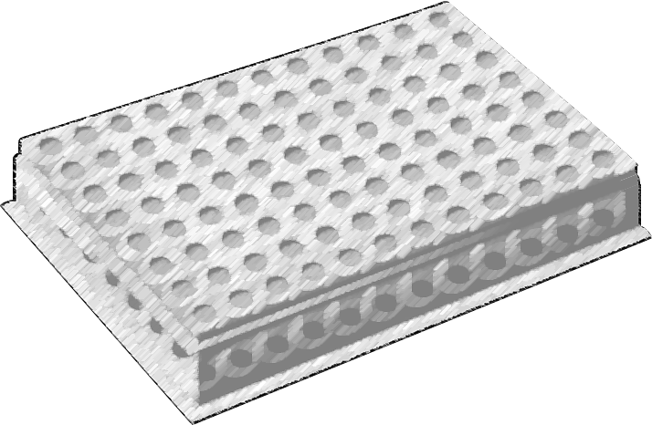

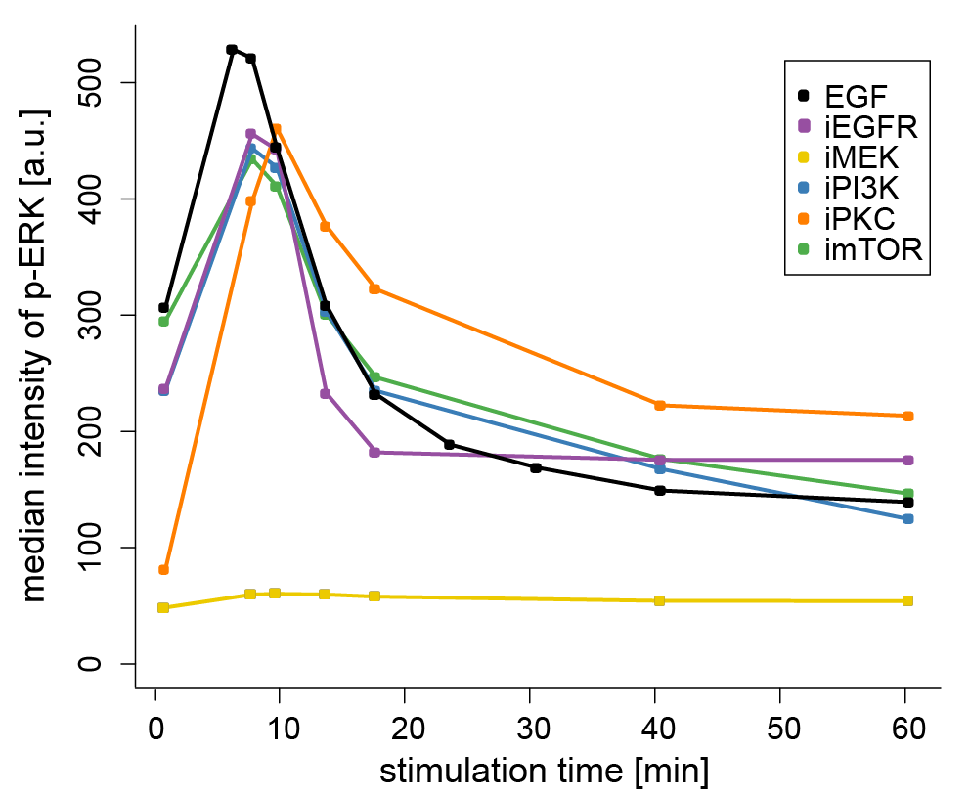
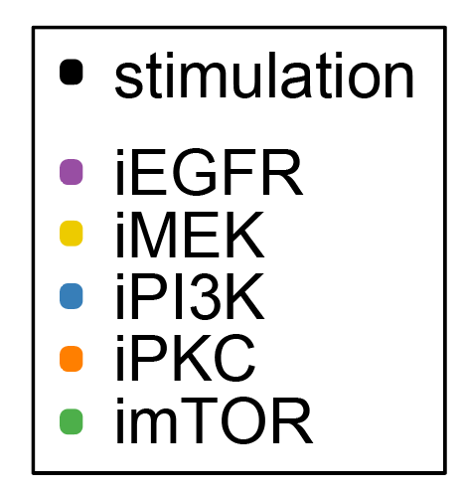
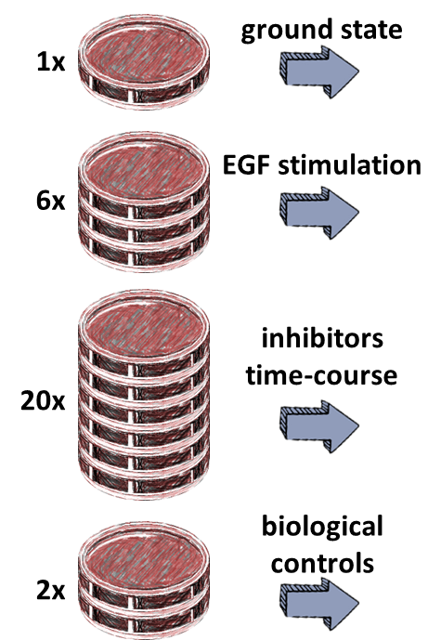
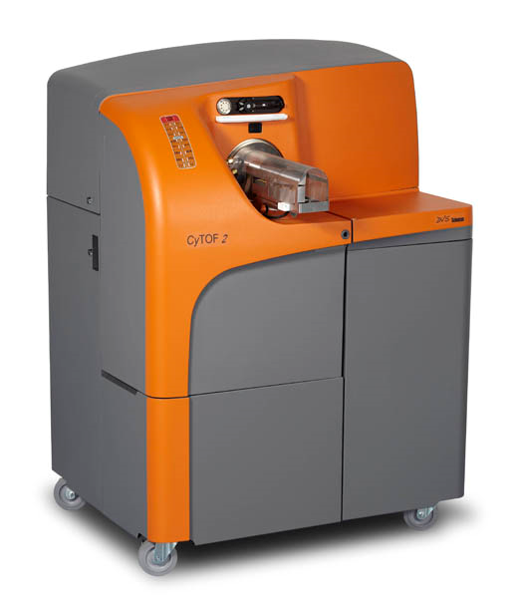
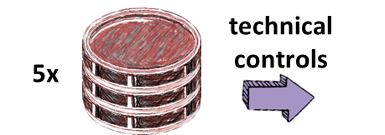
approach I experimental workflow: a memory refresh
collection
time-course A
29 samples
67x
for each cell line
barcoding and cyTOF measurement
data analysis
collection
time-course B
63 samples/cell line
total of 4221 samples
40 markers at single cell resolution: 156’177 quantified markers
8 million single cells
29 samples
technical controls
5 samples
2

Slide 3
outline I outline and aims
Overall AIM: provide an update on the analyses/problems from our side. Topics:
Integration of time-points:
trying to make use of the different time points
obtain one measure per cell line (for easier interpretation and to use for drug sensitivity prediction)
show some interesting observations
DIA measurements:
how variable is the expression of the phospho-proteins that we measure by cyTOF?
Is their variability a problem for our conclusions?
3

Slide 4
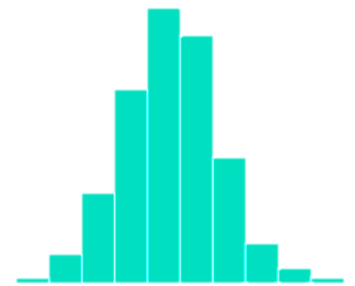
integration I time-course A and B
collection
time-course A
29 samples
67x
for each cell line
barcoding and cyTOF measurement
data analysis
collection
time-course B
63 samples/cell line
total of 4221 samples
40 markers at single cell resolution: 156’177 quantified markers
8 million single cells
29 samples
technical controls
5 samples
4

Slide 5
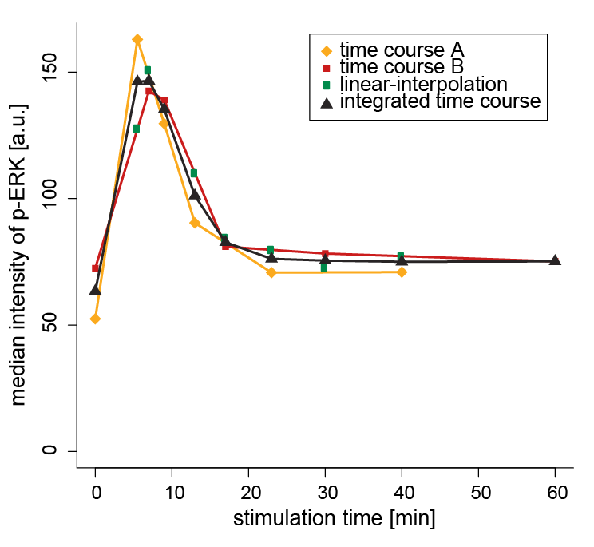
integration I linear interpolation for the non-overlapping time-points and then calculate the average
Replicate A | Replicate B
0 | 0
5.5 | 7
9 | 9
13 | 17
23 | 30
40 | 60
5

Slide 6
integration I same for the inhibitors time courses
6

Slide 7
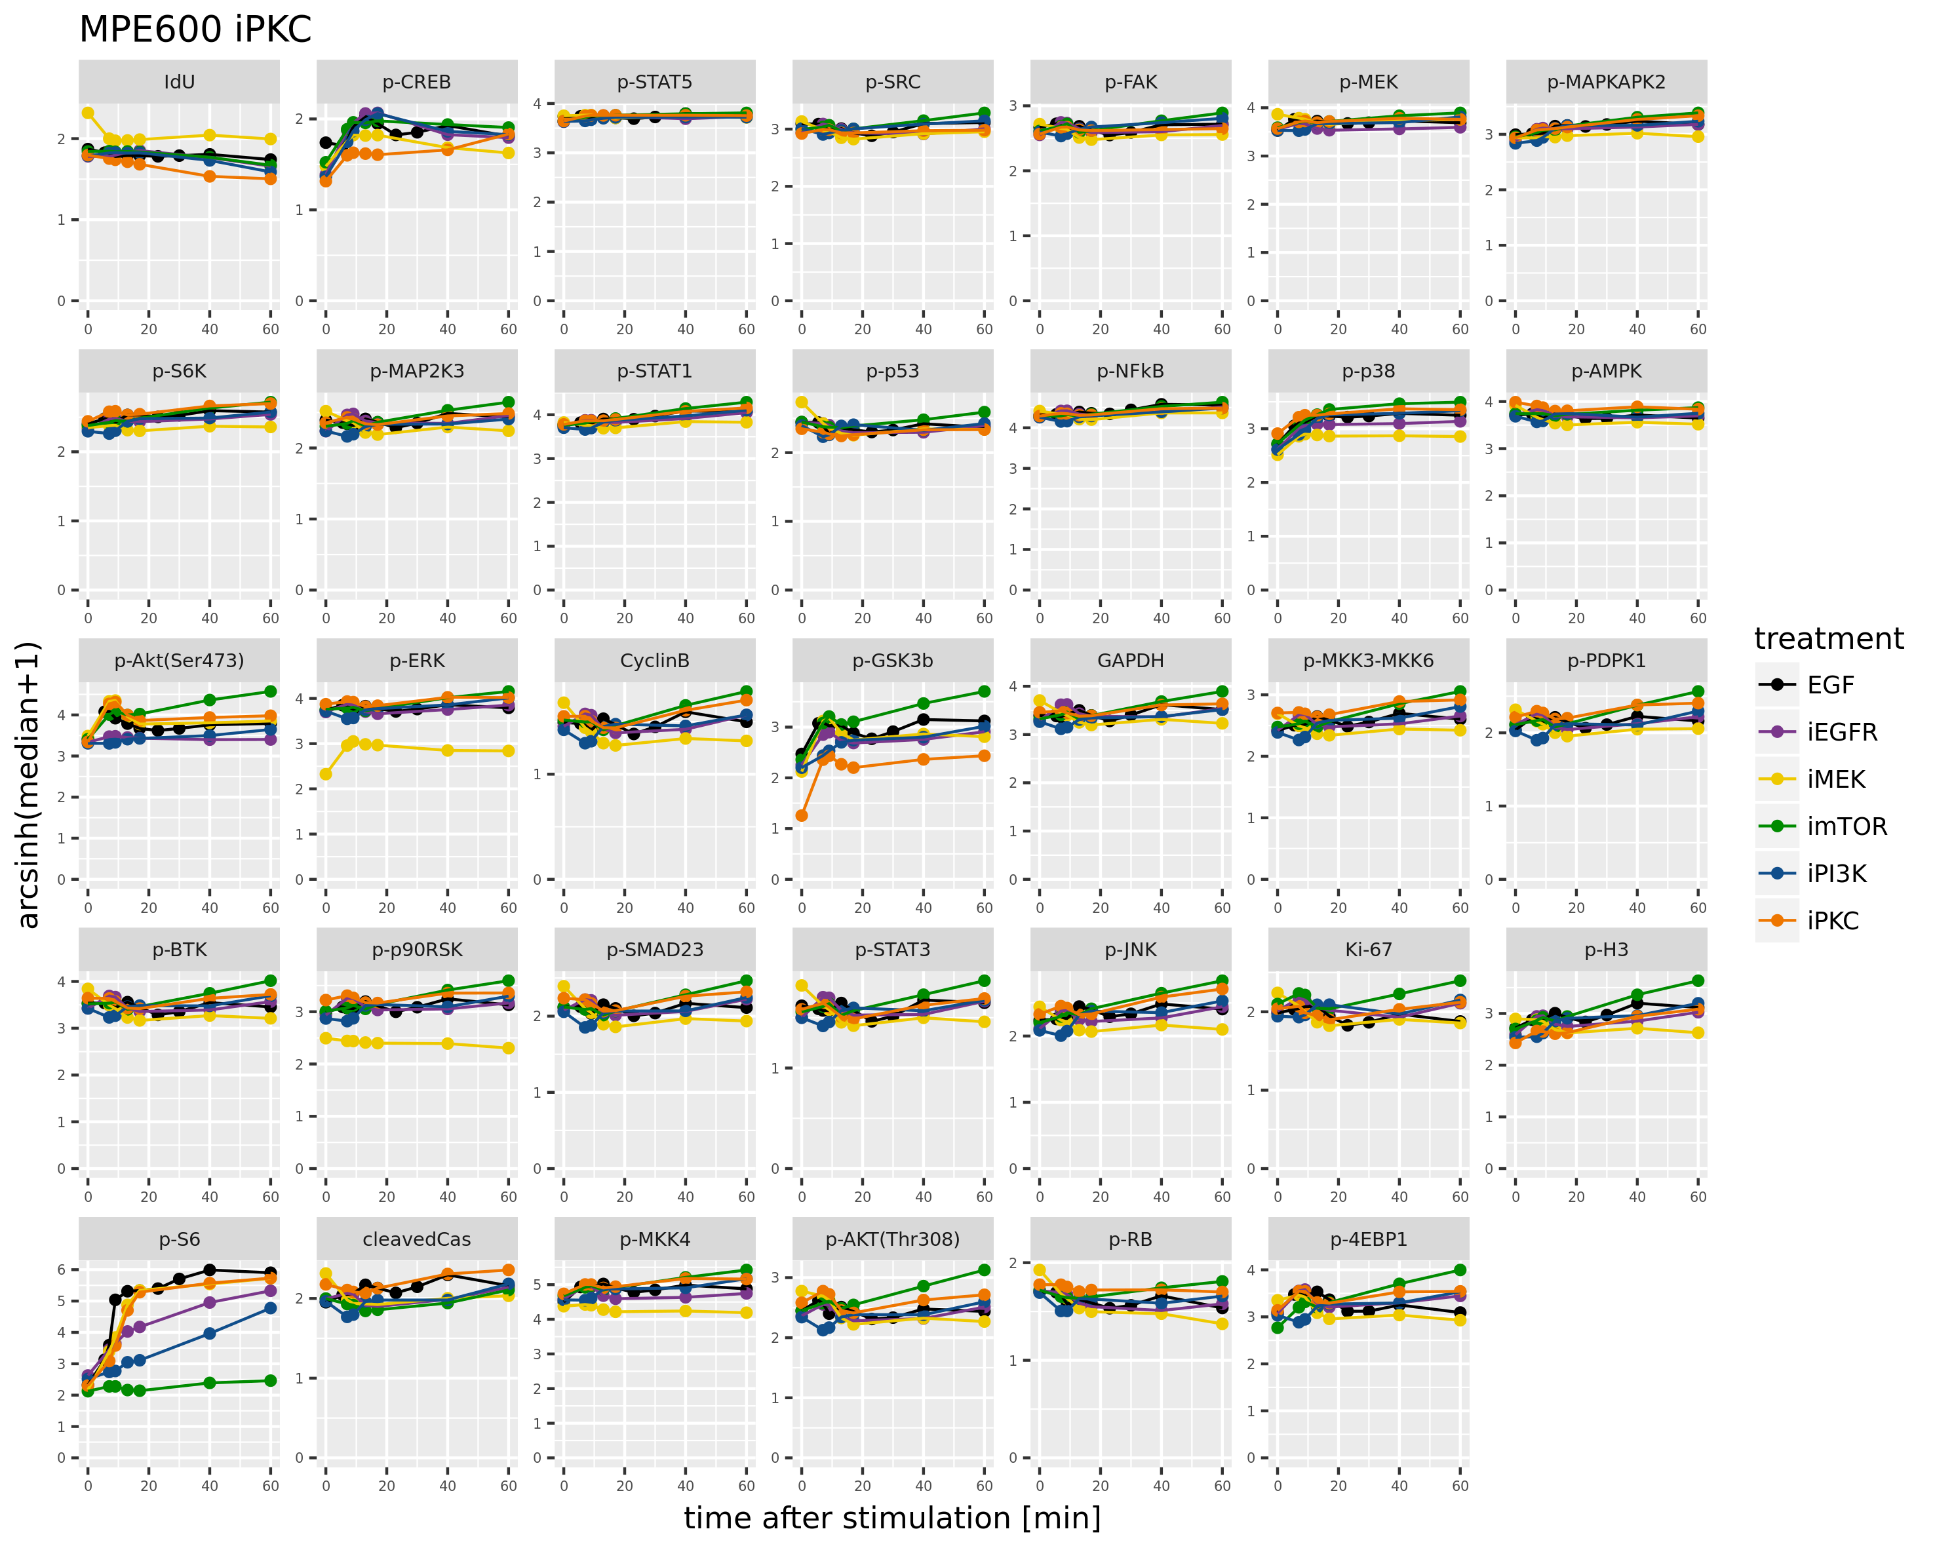
integration I for each of the 67 cell lines
data availability
CellLines.zip
Median_allsamples_tci.rds
7

Slide 8
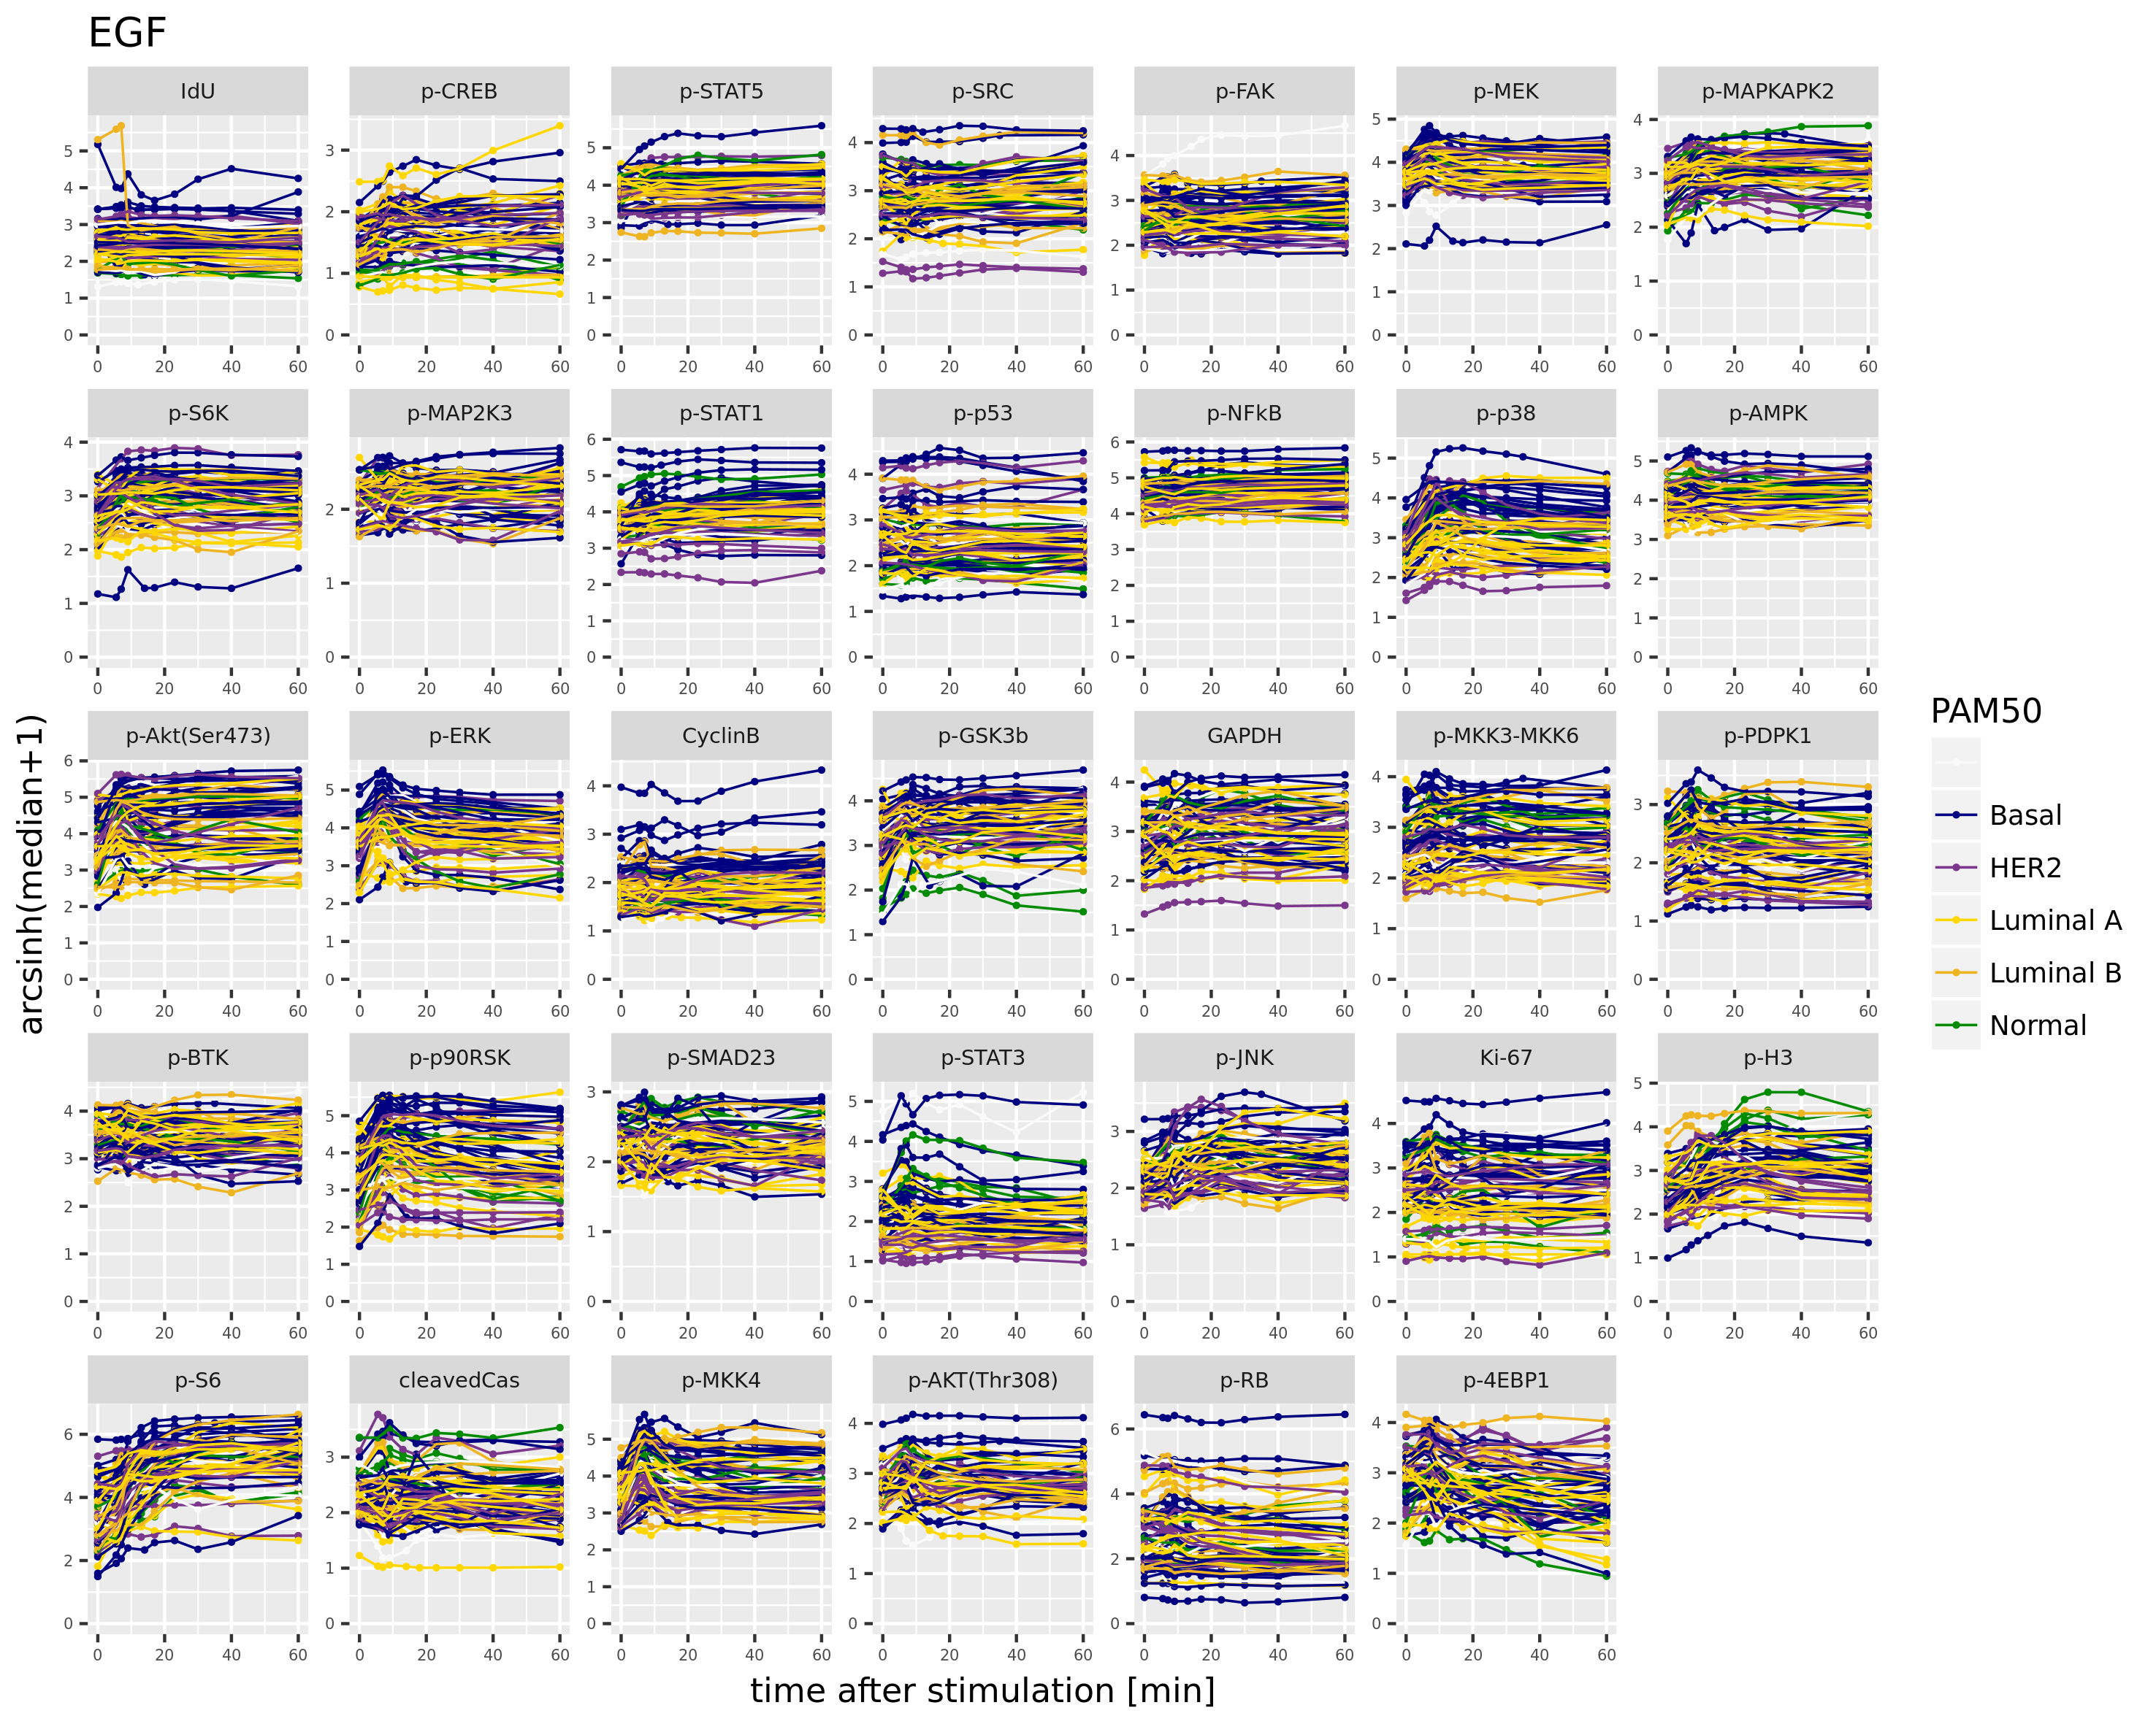
integration I signaling responses across all cell lines, colored by PAM50 classification
some interesting behaviours
p-STAT3 HER2 cell lines have lower levels
Ki-67, p-P38, p-ERK basal cell lines have overall higher levels
p-H3 normal cell lines respond stronger than the other cell lines
lots of information difficult to digest, need to simplify it: one possibility obtain one measurement per time-course -> AUC
similar patters as with the median
PAM50.zip
8

Slide 9
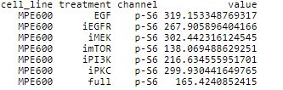
integration I condense the time-course into one measurement: AUC
calculate the Area Under the Curve (AUC) for each measured marker for an approximation of pathway activity
if flat it can still have a large value as it depends on the height of the curve
for the “full” condition we integrate the value one value over 60 minutes (flat line)
in the case of the last time-point (60 minutes) is an NA we approximate it to the closes measured time-point (such that we always integrate over the same “length”)
integration
should we remove the time-point 0 “basal” expression: this would allow us to look at markers changing in phosphorylation levels over time and not at constant levels (since they are relative and highly dependent on the antibody concentration used)?
other possibility is to center each time-course to 0 to just obtain a measure of signal variability
9

Slide 10
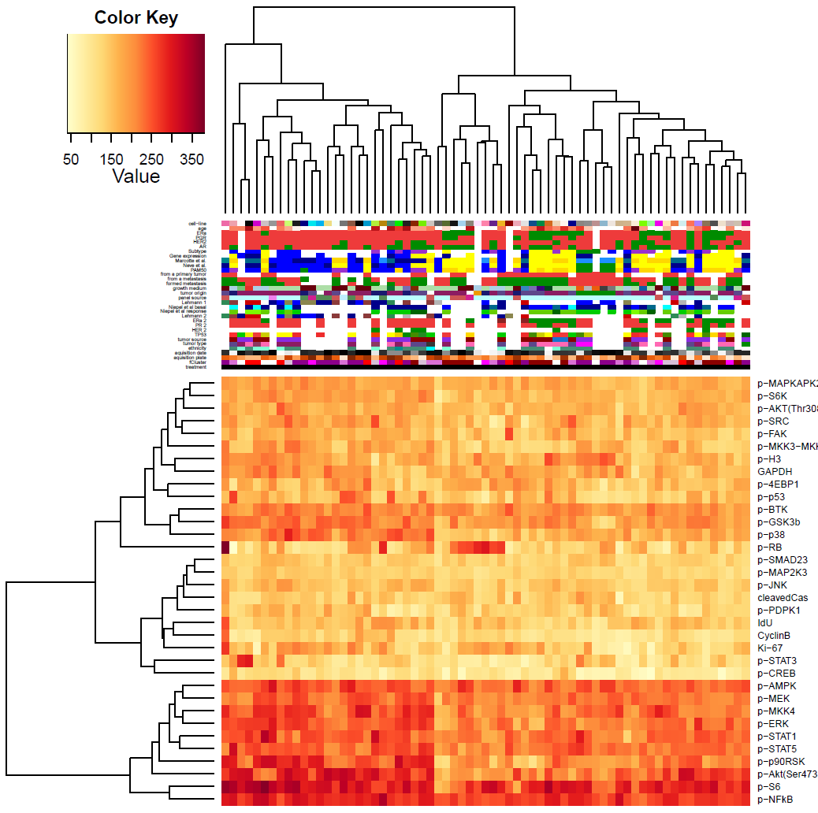
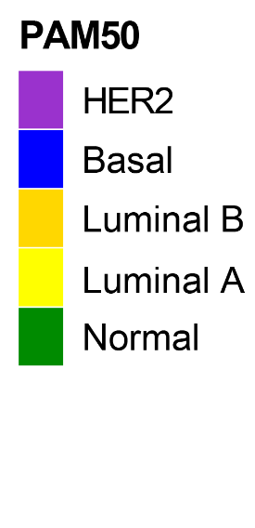
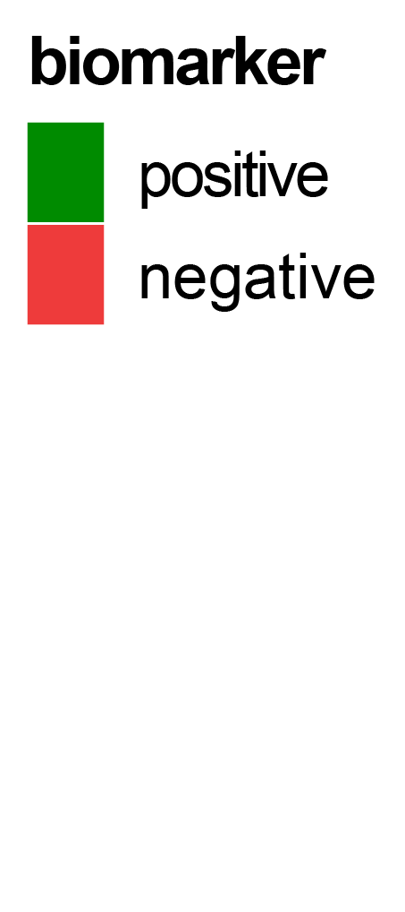
integration I AUC: EGF stimulation
nice luminal/basal segregation
normal samples cluster together (higher p-STAT3 and p-H3 than the luminal samples; lower p-AKT473, p-STAT1 and p-P90RSK than basal)
still lots of information difficult to digest: often we are just interested on comparisons between treatments -> AUC difference
Integration.zip
Median_integrated.rds
10

Slide 11
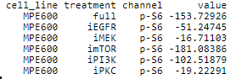
integration I AUC difference
calculate the difference in AUC between different treatment conditions
always relative to AUC in EGF stimulation
obtain a value reflecting the effect of the inhibitor for each measured node; how big is the effect of that treatment on a specific node
integration
difference
11

Slide 12
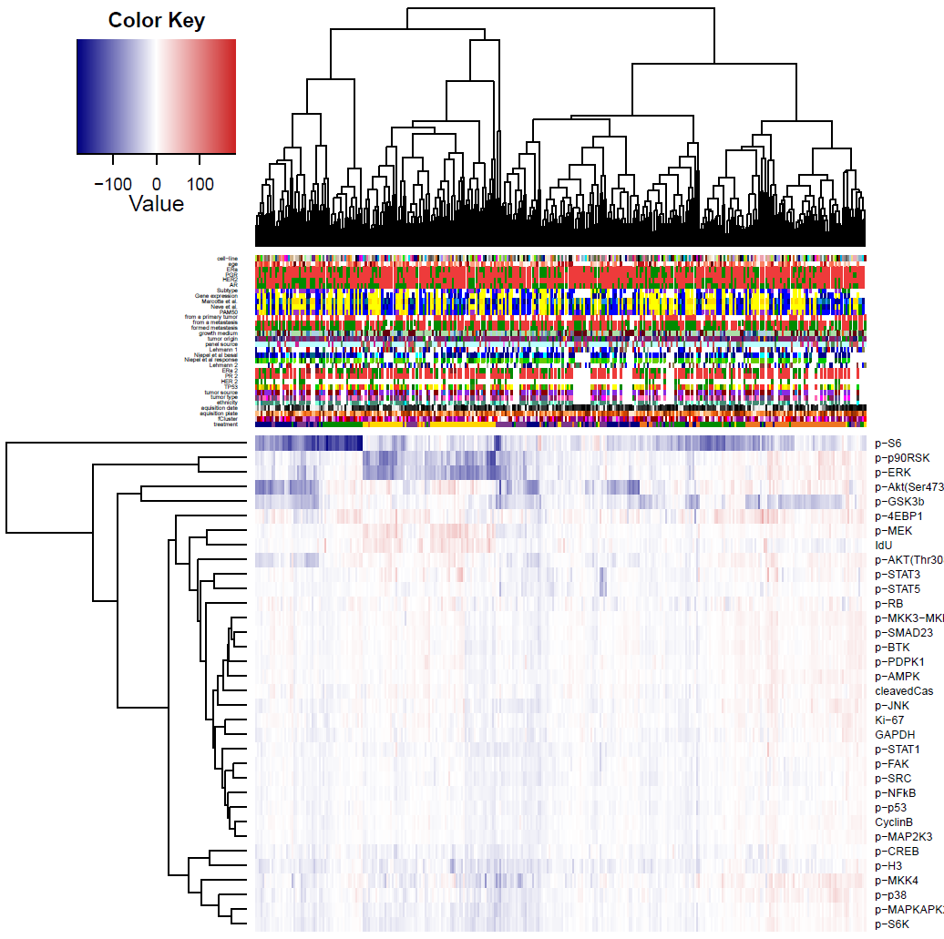
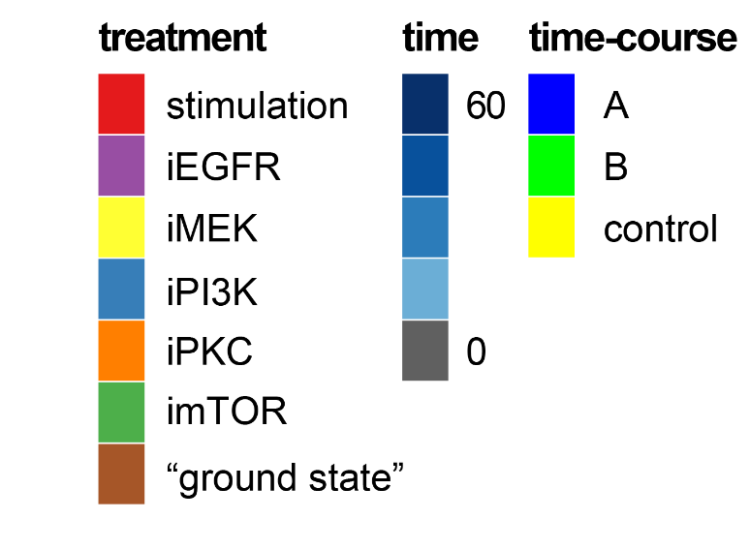
integration I AUC difference
nice treatment specific segregation
we see nicely the expected main targets of the different inhibitors
of interest is how variable the response to iEGFR/iPI3K can be and the markers that increase their signaling upon inhibition
Difference.zip
Median_difference.rds
12

Slide 13
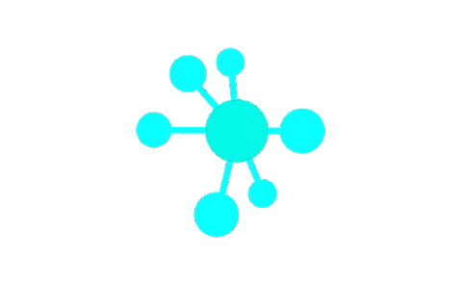
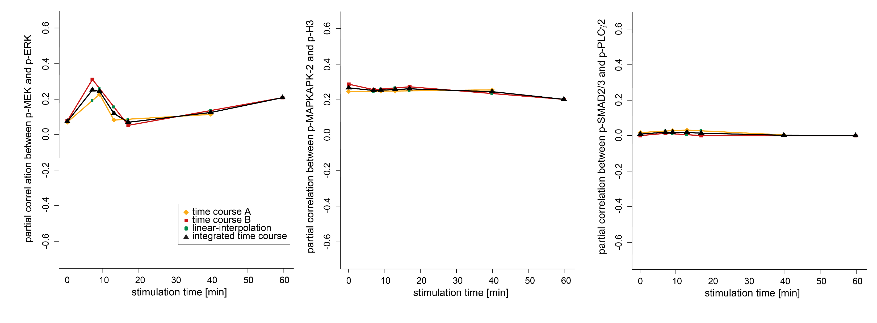
integration I same approach for the partial correlation as for the median
similar patters as with the median
13

Slide 14
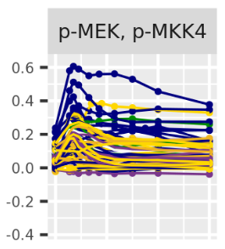
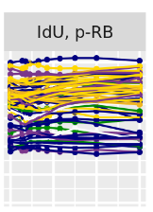
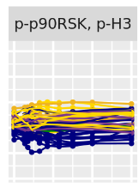
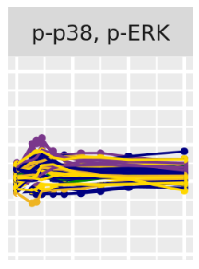
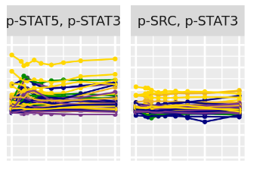
integration I across all cell lines: some notable examples
14

Slide 15
integration I summary and open questions
time-point integration and extraction of one value per condition
test how these measurements perform in drug sensitivity prediction
try a more complex approach? E.g. a non-linear interpolation of the time-course?
see how these measurements perform across the clinical sub-groups (compute averages per group)
15

Slide 16
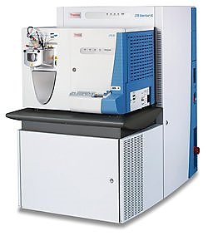
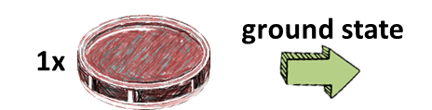
DIA I DIA measurements: experimental setup
ground state
collection
time-course A
29 samples
67x
for each cell line
67x
for each cell line
DIA
measurement
ground state
barcoding and cyTOF measurement
data analysis
collection
3 samples/cell line
total of 201 samples
time-course B
63 samples/cell line
total of 4221 samples
40 markers at single cell resolution: 156’177 quantified markers
8 million single cells
29 samples
ground state
technical controls
5 samples
16

Slide 17
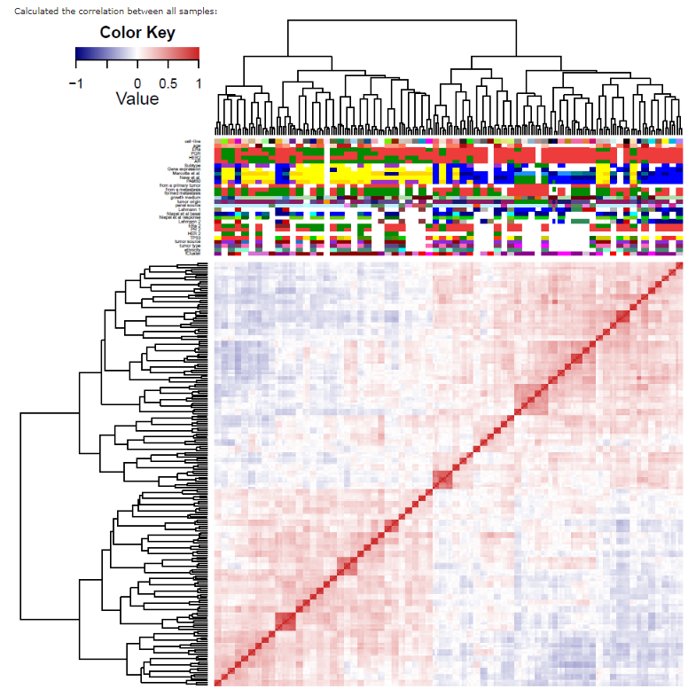
DIA I DIA measurements: the sample correlation
how variable is the expression of the total protein level of the phosphor-proteins that we measure by cyTOF?
17

Slide 18
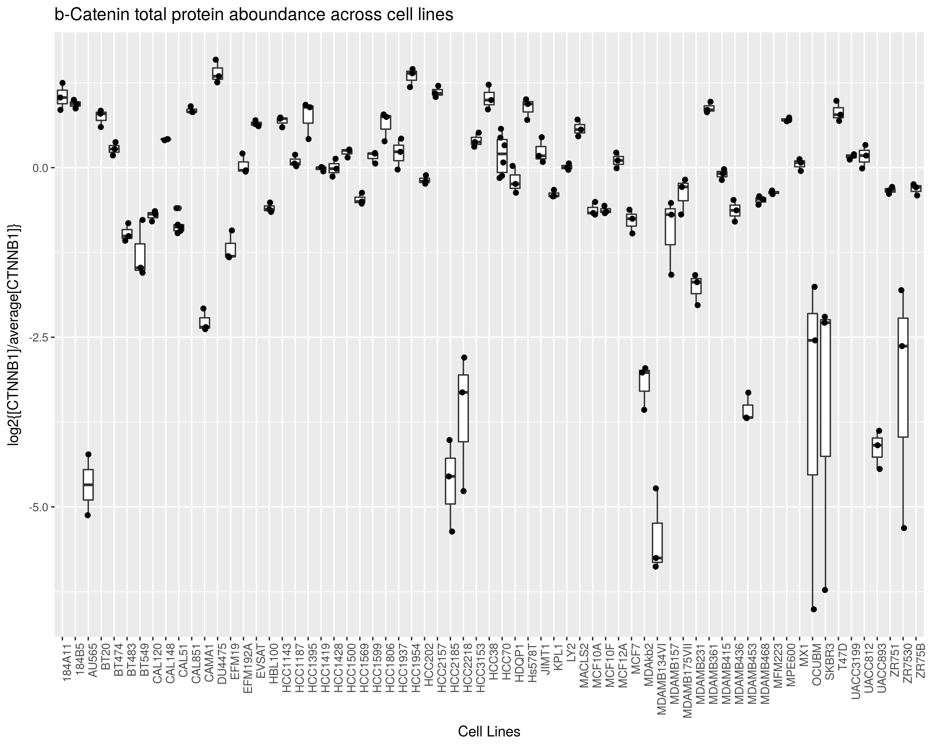
DIA I expression of the proteins measured by cyTOF: high variance
cyTOF marker
protein
measured
by proteomics
expression.zip
18

Slide 19
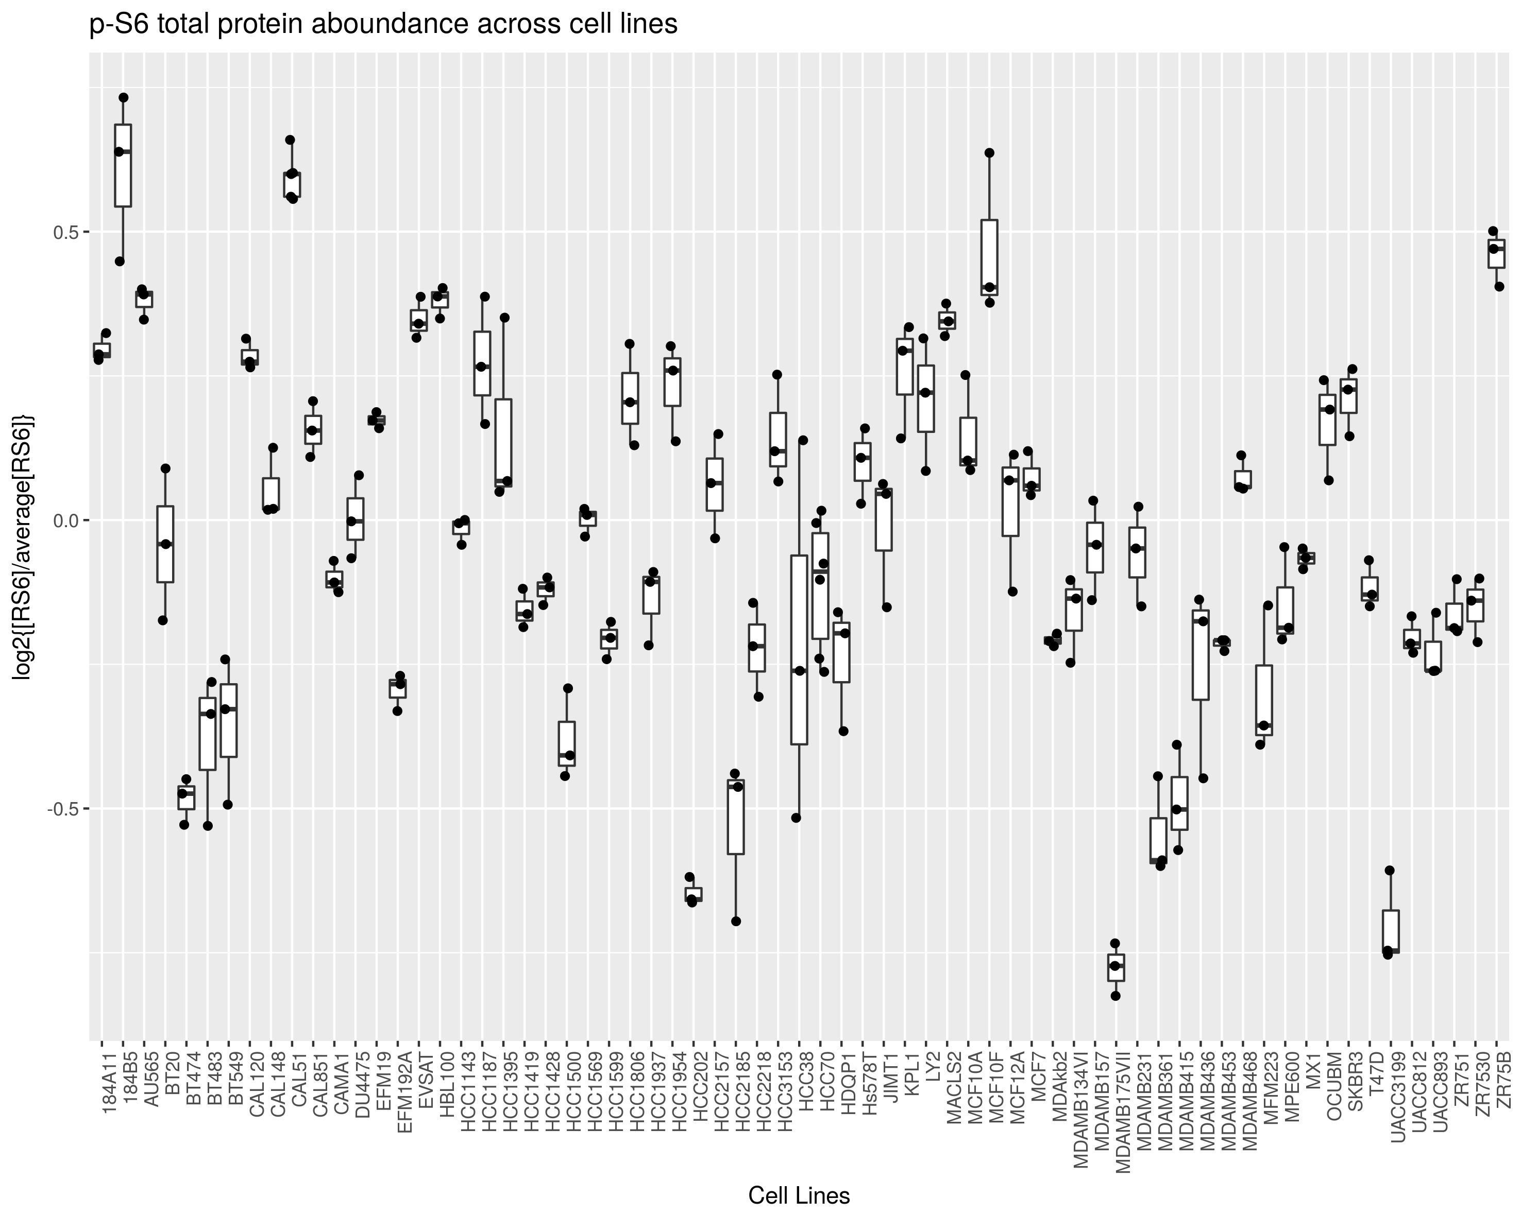
DIA I expression of the proteins measured by cyTOF: low variance
expression.zip
19

Slide 20
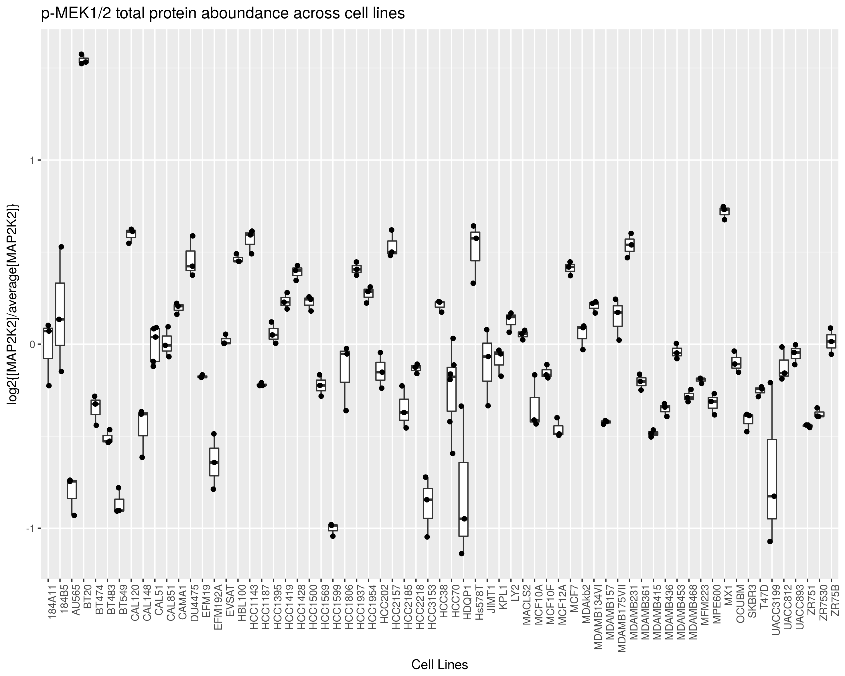
DIA I expression of the proteins measured by cyTOF: low variance
not all cyTOF measured proteins were detected by proteomics
often multiple genes for one measured phosphor site (eg ERK1 and ERK2)
do we need a quantitative measure?
expression.zip
20

Slide 21
DIA I summary and open questions
overall quite conserved across cell lines
but can be quite different for some cell lines
should we measure their expression by cyTOF?
should we try to normalize the cyTOF measurements with the proteomic measurements? protein levels strongly affect phospho-levels
21

